Slide 1

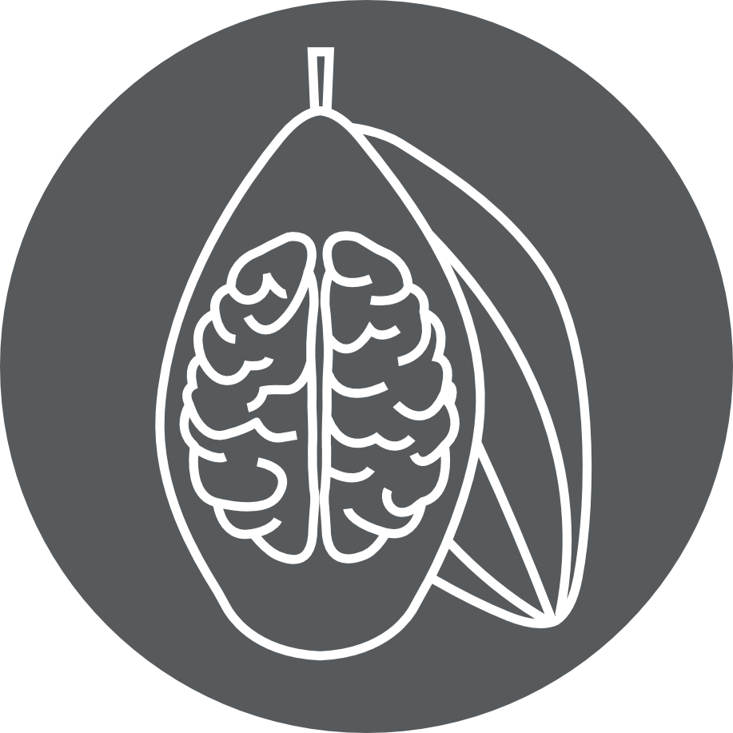
Affective Neuroscience | Fall 2020
Lecture 04
Lecture 04
Pleasure and desire
CHOONG-WAN WOO | COCOAN lab | http://cocoanlab.github.io
Many slides are modified from Tor D. Wager’s slides

Slide 2
Lecture 04
Opioid and dopamine systems
CHOONG-WAN WOO | COCOAN lab | http://cocoanlab.github.io

Slide 3
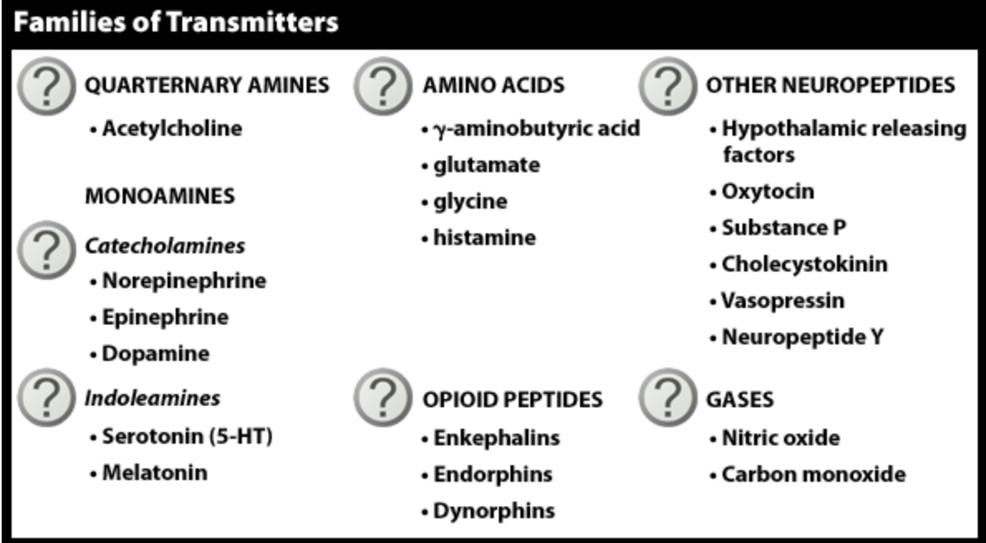
Lecture 04
Opioid and dopamine systems
Families of neurotransmitters
CHOONG-WAN WOO | COCOAN lab | http://cocoanlab.github.io

Slide 4
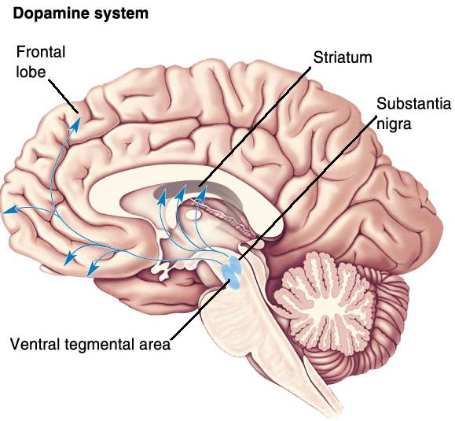
Lecture 04
Dopamine system
Main production centers: VTA and SN
Projections:
To limbic system (mesolimbic)
To cortex (mesocortical)
To basal ganglia (nigrostriatal)
Functions:
Reward, motivation
Learning, esp. about rewards
Many types: Social rewards, drug rewards, food rewards, others
Emotions: love, aesthetics
CHOONG-WAN WOO | COCOAN lab | http://cocoanlab.github.io

Slide 5
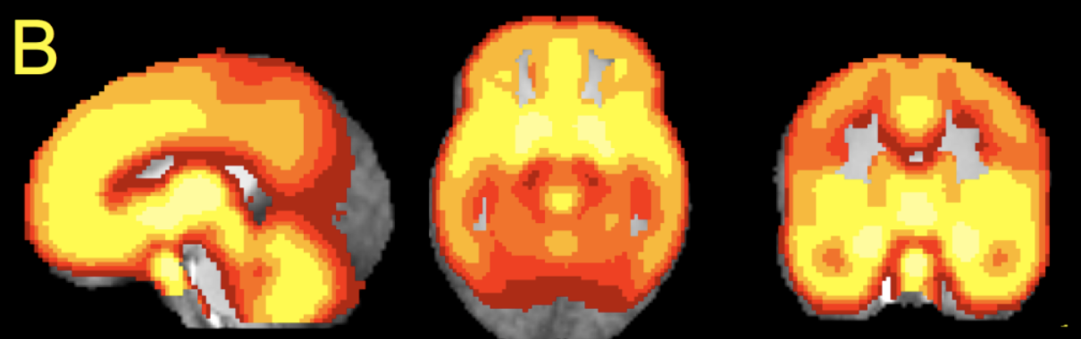
Benarroch 2012; Wager et al., 2007 Lecture 04
Opioid system
Main production centers: PAG, hypothalamus, striatum, etc.
Projections:
To brainstem and spinal cord
To limbic system (esp. thalamus, accumbens/ventral striatum)
To cortex (esp. medial prefrontal)
Functions:
Pain modulation
Pleasure
Pro-parasympathetic
Buffering against ‘social’ pain?
Highly addictive
Opioid binding sites
CHOONG-WAN WOO | COCOAN lab | http://cocoanlab.github.io

Slide 6
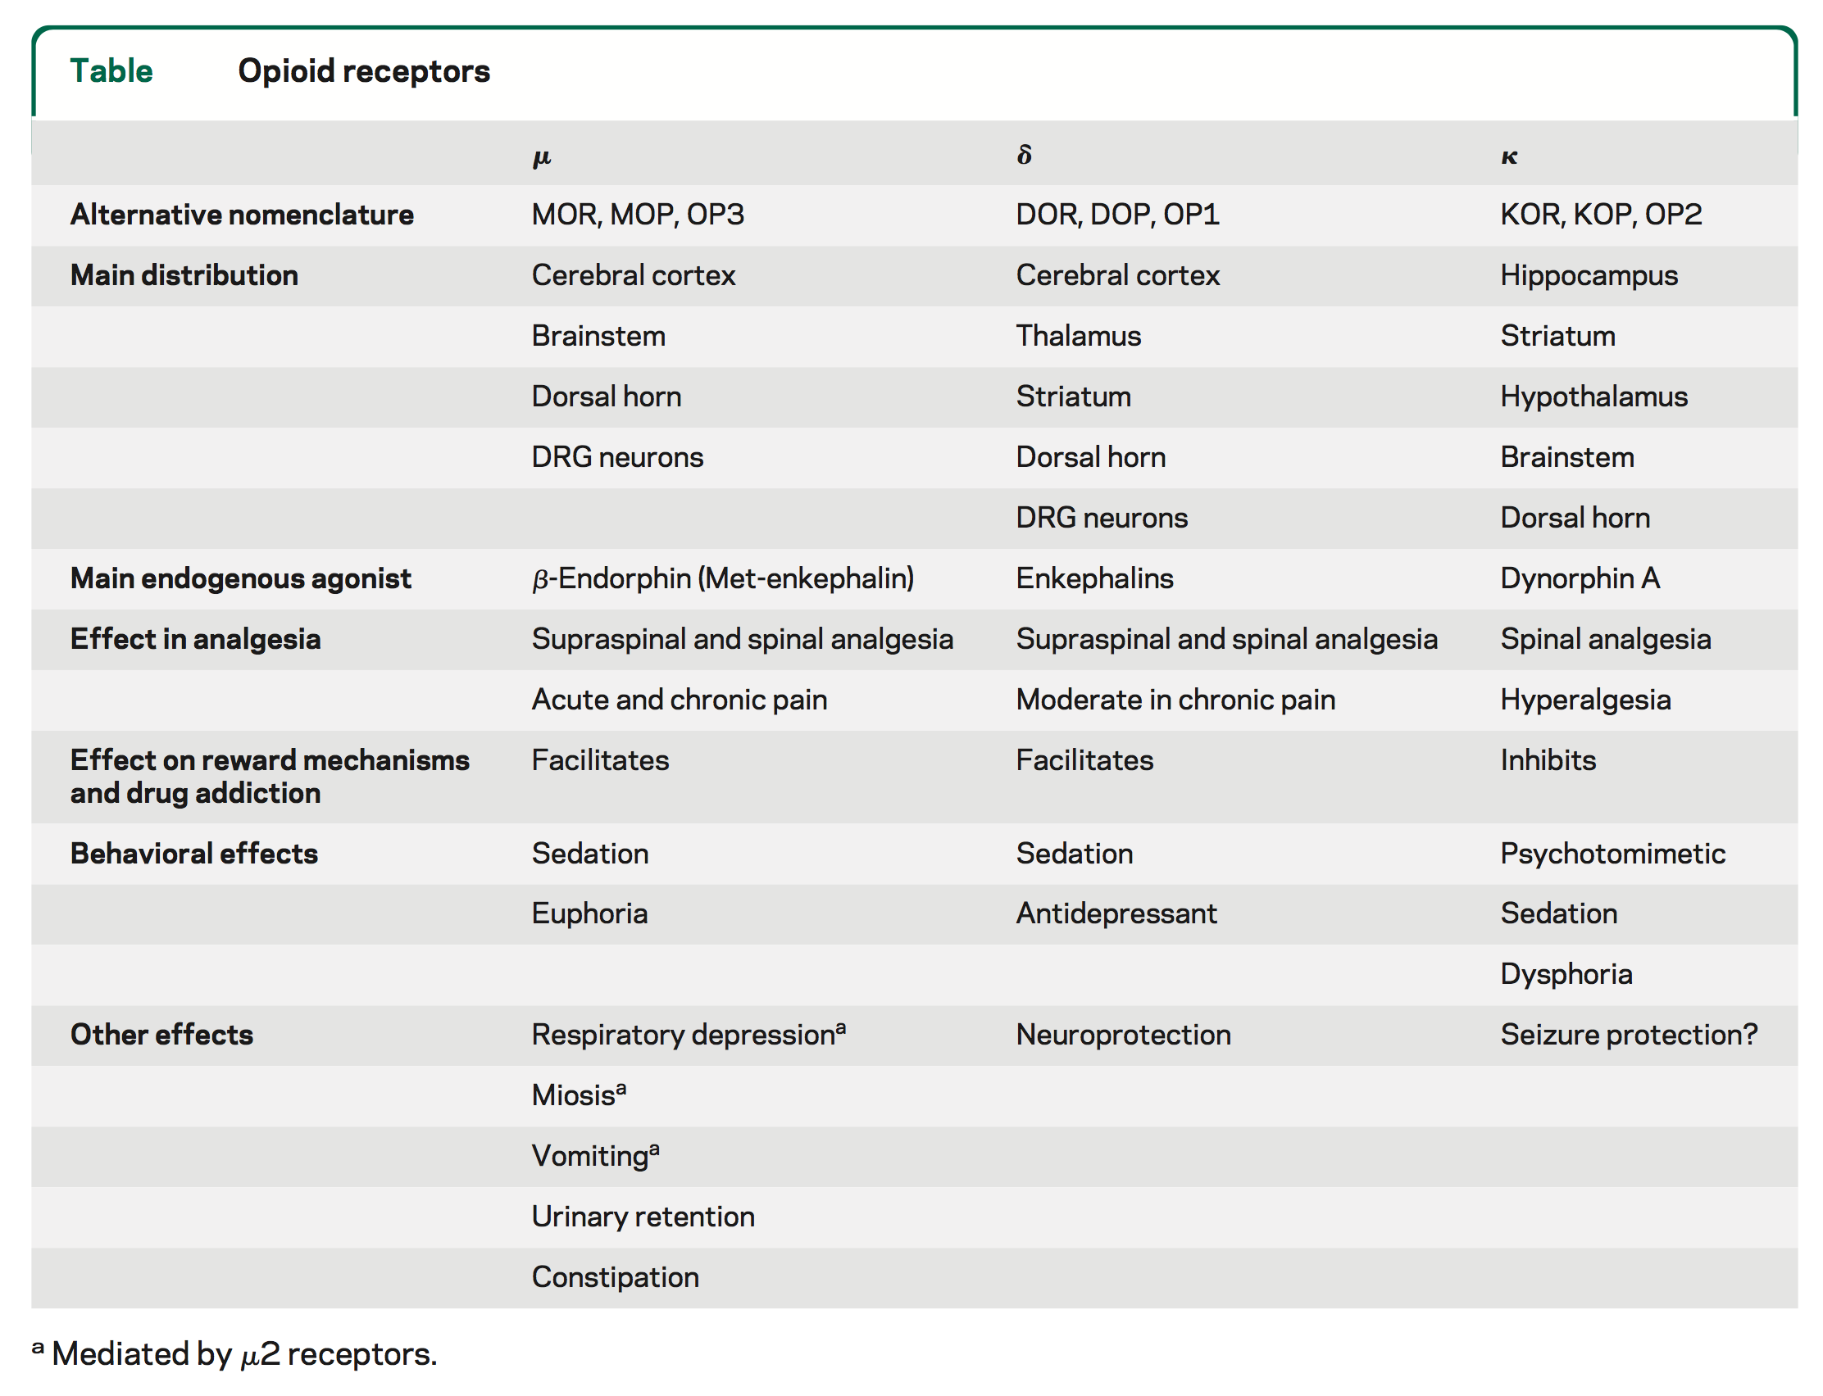
Benarroch 2012 Lecture 04
Opioid system
Main production centers: PAG, hypothalamus, striatum, etc.
Projections:
To brainstem and spinal cord
To limbic system (esp. thalamus, accumbens/ventral striatum)
To cortex (esp. medial prefrontal)
Functions:
Pain modulation
Pleasure
Pro-parasympathetic
Buffering against ‘social’ pain?
Highly addictive
CHOONG-WAN WOO | COCOAN lab | http://cocoanlab.github.io

Slide 7
Lecture 04
Appetitive and consummatory processes
CHOONG-WAN WOO | COCOAN lab | http://cocoanlab.github.io

Slide 8
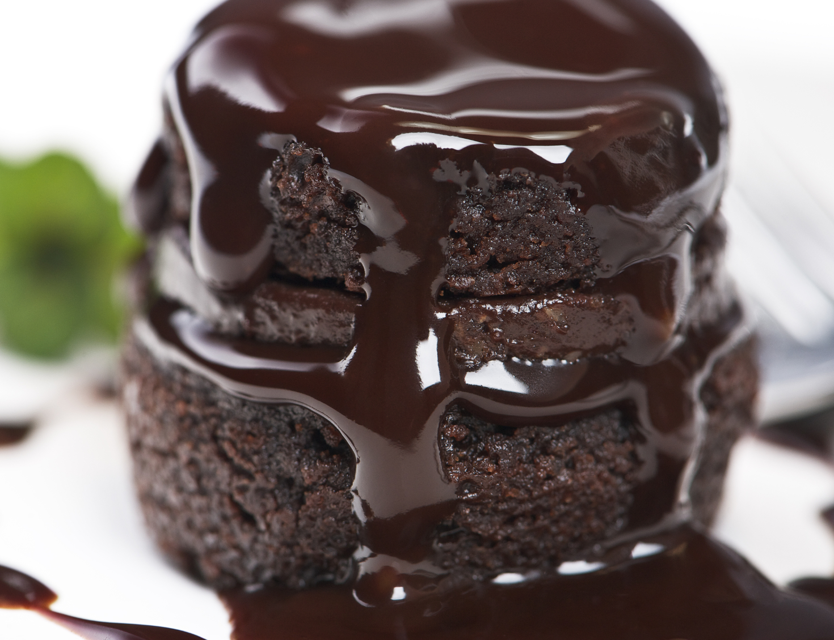
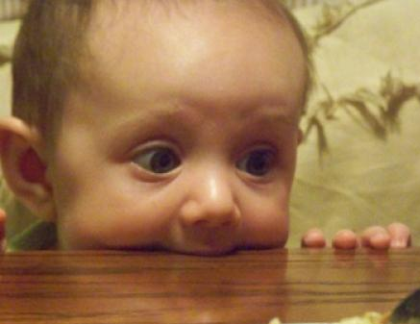
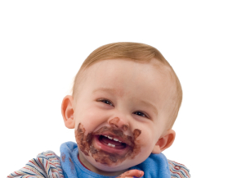
Lecture 04
Appetitive and consummatory processes
Cues
Look
Smell
Appetitive drive
wanting
craving
Consummation
Pleasure
Satisfaction (satiety)
Appetitive processes are generally anticipatory
CHOONG-WAN WOO | COCOAN lab | http://cocoanlab.github.io

Slide 9
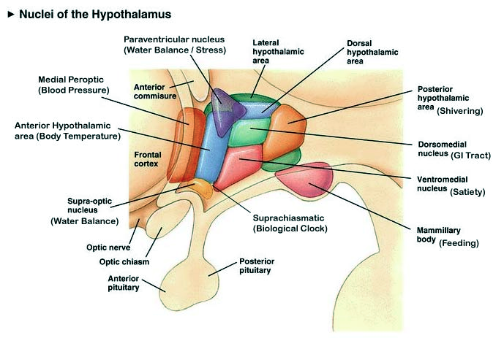
Lecture 04
Brain stimulation and reward
Eating as an example
Hypothalamus:
Stimulation of lateral nuclei: eating
Stimulation of ventromedial area: satiety
CHOONG-WAN WOO | COCOAN lab | http://cocoanlab.github.io
Notes:
CCK:CHOLECYSTOKININ
PYY:PEPTIDE YY
PP: Pancreatic polypeptide

Slide 10
Lecture 04
Brain stimulation and reward
Eating as an example
Hypothalamus:
Stimulation of lateral nuclei: eating
Stimulation of ventromedial area: satiety
Produces hunger-related hormones
ghrelin
insulin
leptin
PYY, CCK, PP
DRIVES or REWARDS?
Is lateral hypothalamus stimulation aversive ‘hunger’ or rewarding?
Lateral hypothalamus
(hunger center)
ventromedial hypothalamus
(satiety center)
CHOONG-WAN WOO | COCOAN lab | http://cocoanlab.github.io
Notes:
CCK:CHOLECYSTOKININ
PYY:PEPTIDE YY
PP: Pancreatic polypeptide

Slide 11
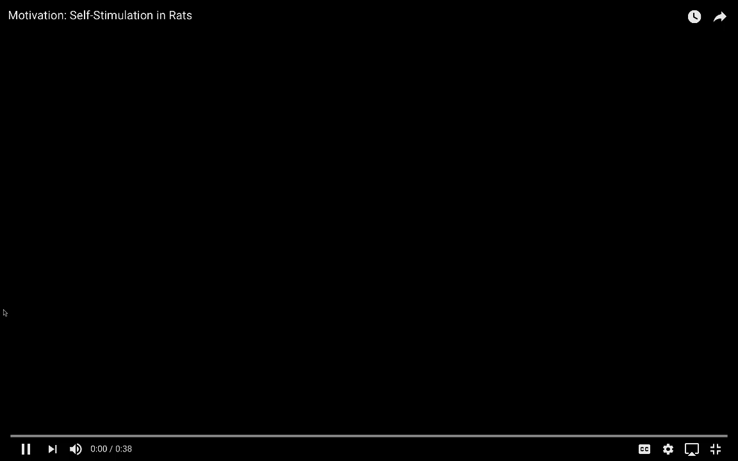
Lecture 04
Historical brain ‘reward’ centers
E.g., Lateral hypothalamus
Animals self-stimulate (Olds and Milner) http://alfre.dk/the-pleasure-center/
CHOONG-WAN WOO | COCOAN lab | http://cocoanlab.github.io
Notes:
CCK:CHOLECYSTOKININ
PYY:PEPTIDE YY
PP: Pancreatic polypeptide

Slide 12
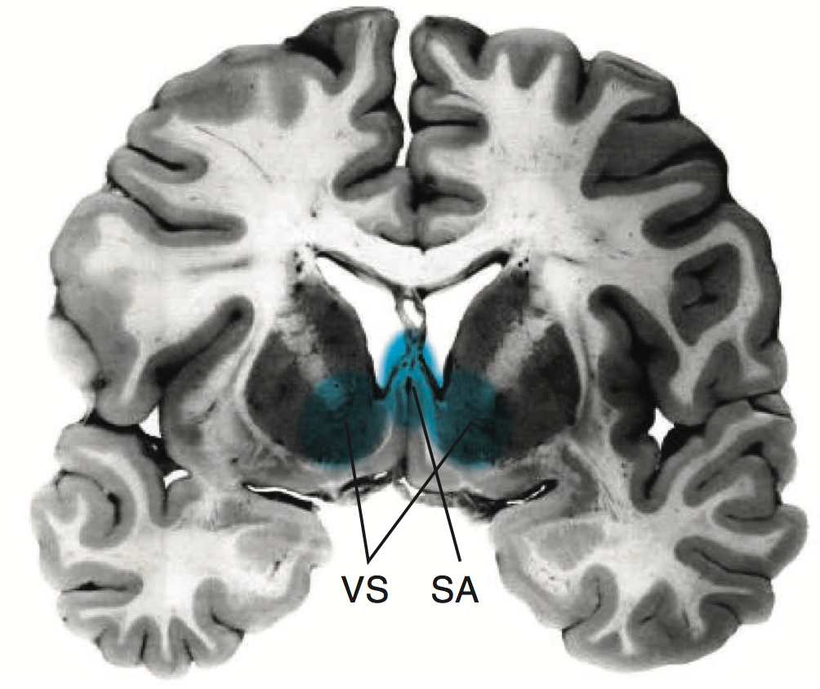
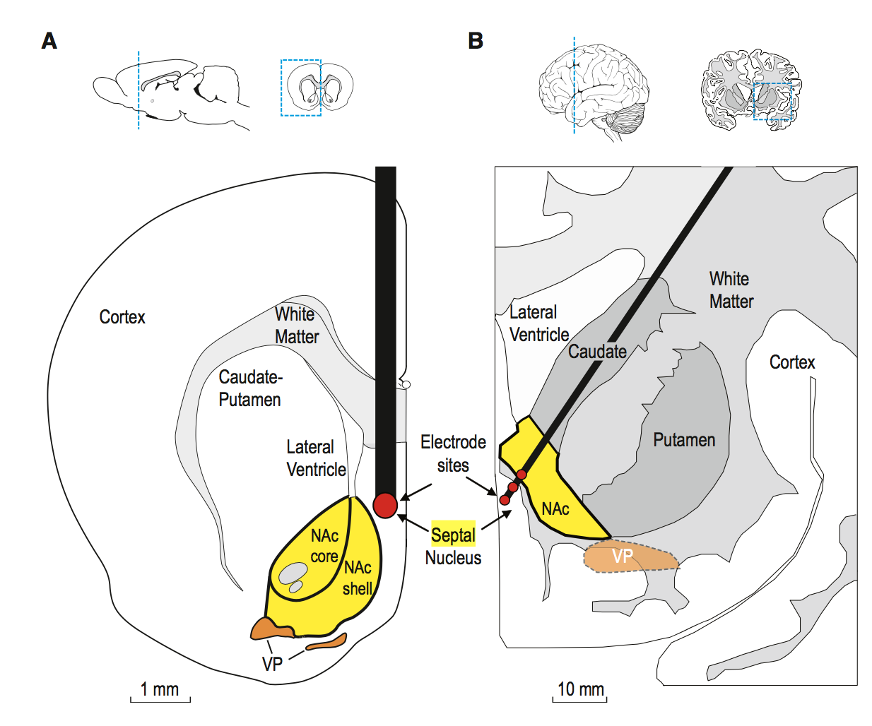
Lecture 04
Historical brain ‘reward’ centers
E.g., Lateral hypothalamus
Animals self-stimulate (Olds and Milner) http://alfre.dk/the-pleasure-center/
Other ‘reward’ centers:
Septal nuclei
Nucleus accumbens (DA)
Ventral tegmental area (DA system)
‘Reward centers’: Stimulation elicits pursuit of rewards
Natural (food)
Drug
Can depend on satiety
But does it feel good?
SA: septal area
VS: ventral striatum (nucleus accumbens)
CHOONG-WAN WOO | COCOAN lab | http://cocoanlab.github.io
Notes:
CCK:CHOLECYSTOKININ
PYY:PEPTIDE YY
PP: Pancreatic polypeptide

Slide 13
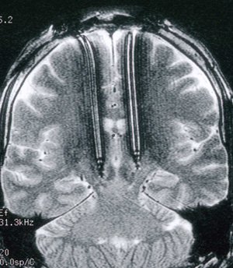
Portenoy et al., 1986 Lecture 04
‘False pleasure electrodes’?
Woman (40 yrs-old) in 1980s study
Thalamic electrode to control pain
"At its most frequent, the patient self-stimulated throughout the day, neglecting personal hygiene and family commitments”
“Though sexual arousal was prominent, no orgasm occurred"
“She described erotic sensations often intermixed with an undercurrent of anxiety. She also noted extreme thirst, drinking copiously during the session, and alternating generalized hot and cold sensations"
They seem related to “pleasure”, but it’s unclear that they really caused “pleasure”
Alternative explanation: compulsive “wanting”?
CHOONG-WAN WOO | COCOAN lab | http://cocoanlab.github.io
Notes:
CCK:CHOLECYSTOKININ
PYY:PEPTIDE YY
PP: Pancreatic polypeptide

Slide 14
Berridge 2009 Lecture 04
Liking and wanting: Two building blocks of reward
Emotion
Positive affect (reward)
Building Blocks
‘Like’
‘Want’
CHOONG-WAN WOO | COCOAN lab | http://cocoanlab.github.io
Notes:
CCK:CHOLECYSTOKININ
PYY:PEPTIDE YY
PP: Pancreatic polypeptide

Slide 15
Lecture 04
Roles of opioid and dopamine systems in wanting and liking
CHOONG-WAN WOO | COCOAN lab | http://cocoanlab.github.io

Slide 16
Lecture 04
Measuring wanting and liking
Measuring wanting…
is not easy…
Look at pursuit, consumption
Animals:
Nose pokes for reward
Humans:
Craving measures
Choices, pursuit
CHOONG-WAN WOO | COCOAN lab | http://cocoanlab.github.io
Notes:
CCK:CHOLECYSTOKININ
PYY:PEPTIDE YY
PP: Pancreatic polypeptide

Slide 17

Lecture 04
Measuring wanting and liking
Measuring liking…
‘Liking’ & ‘Disliking’ expressions to taste
Reflect palatability of physiological hunger, learning, & brain hedonics
CHOONG-WAN WOO | COCOAN lab | http://cocoanlab.github.io
Notes:
CCK:CHOLECYSTOKININ
PYY:PEPTIDE YY
PP: Pancreatic polypeptide

Slide 18
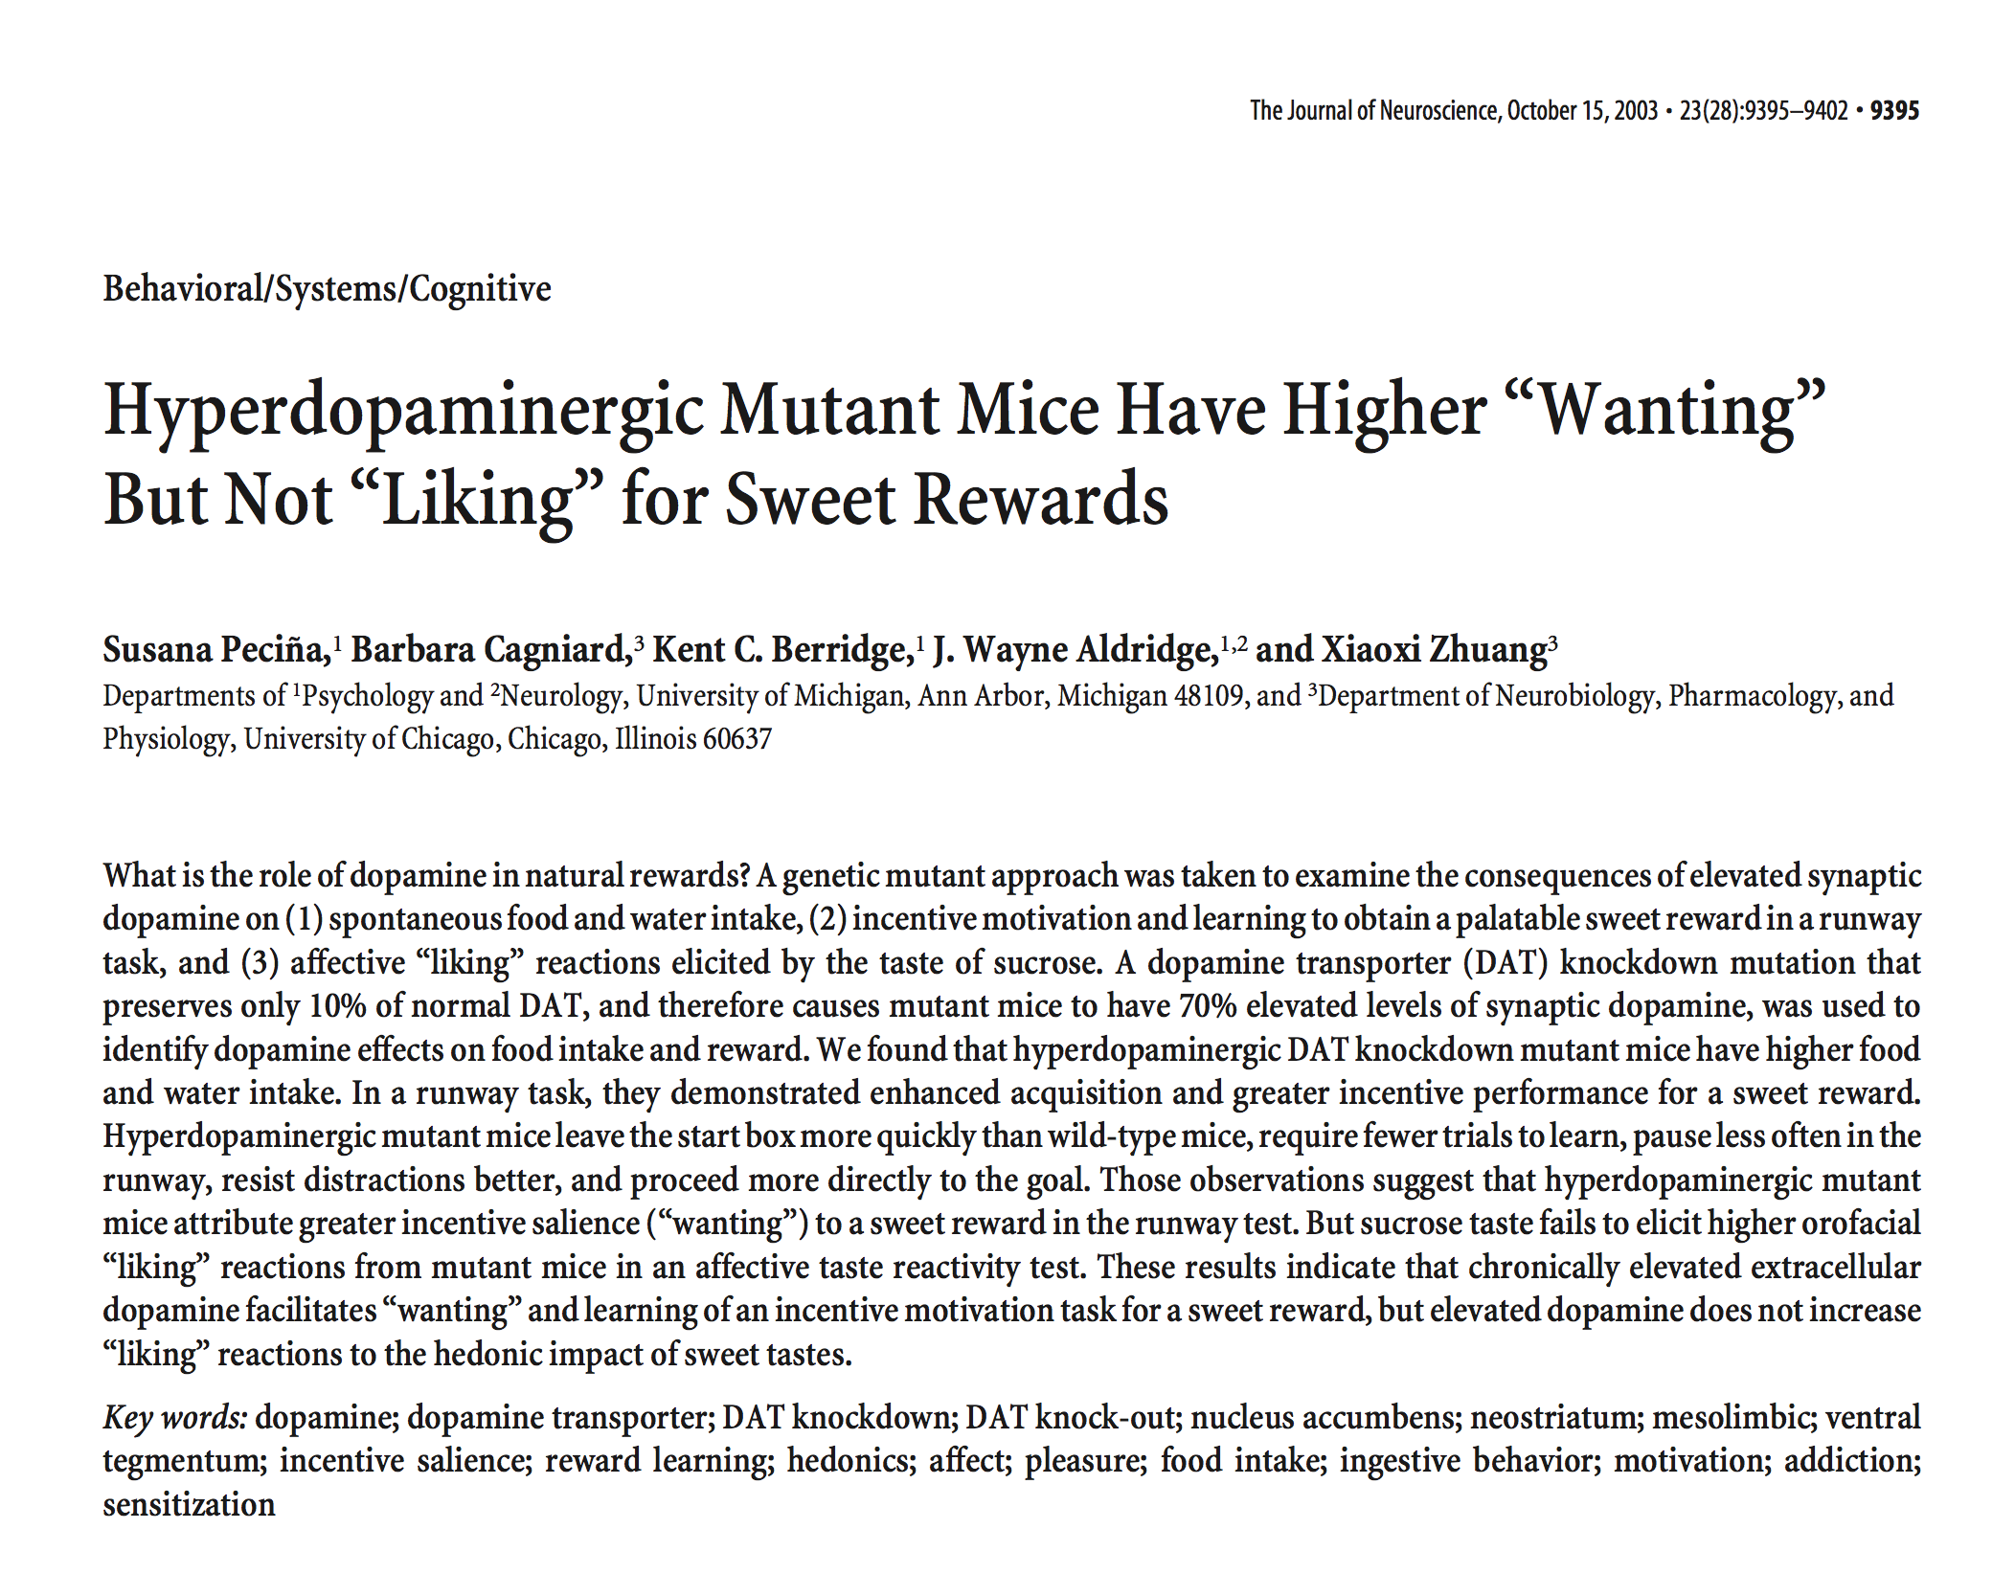
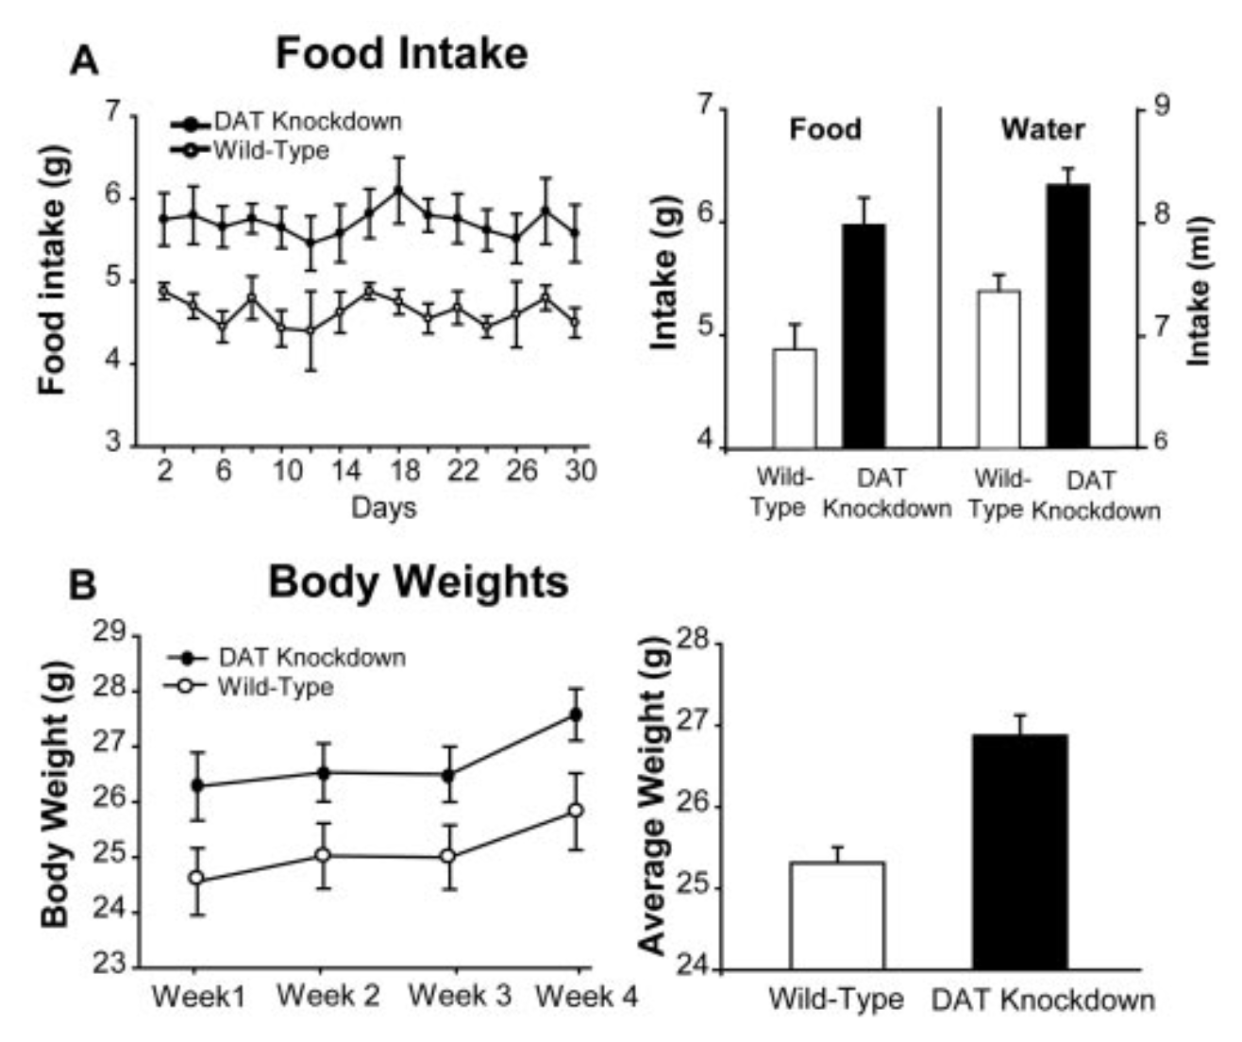
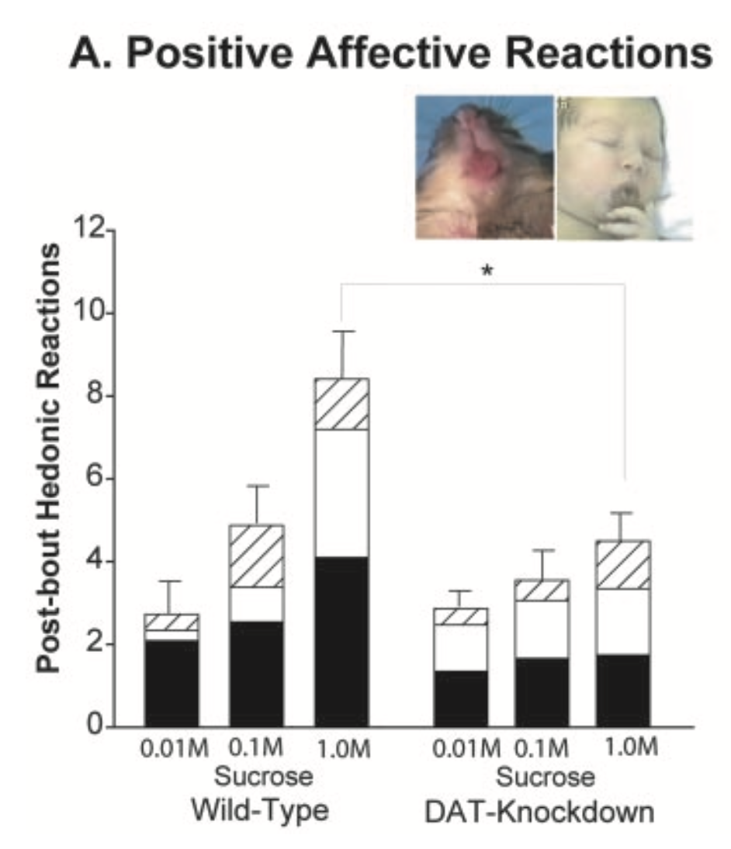
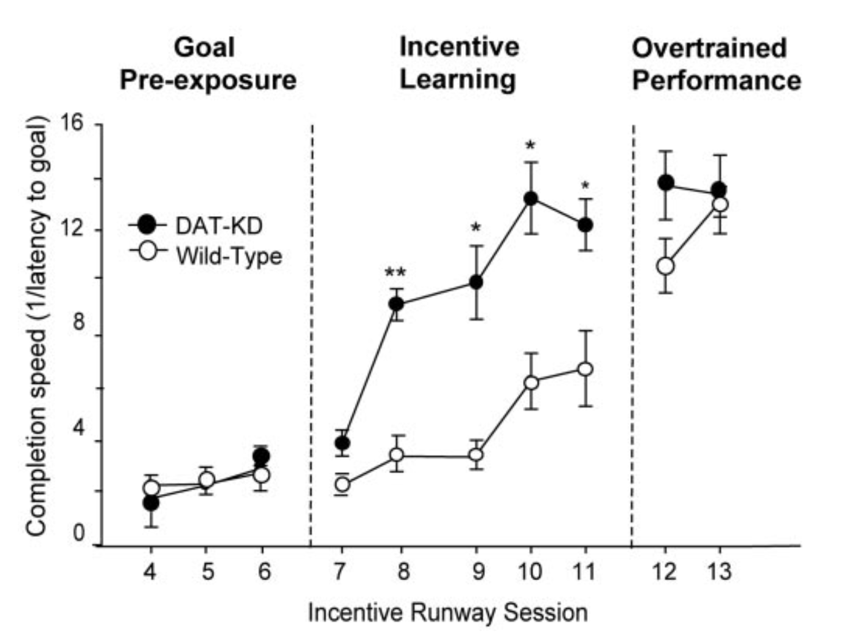
Lecture 04
Hyper-dopamine mutant mouse ‘wants’ rewards more
Dopamine transporter (DAT) knockdown mutation
Extra dopamine signal
Less dopamine transporter for reuptake (10%)
More dopamine in the synapse (70%)
Eat more, weigh more
, more motivated, better learning
But decrease “liking” reactions
CHOONG-WAN WOO | COCOAN lab | http://cocoanlab.github.io
Notes:
CCK:CHOLECYSTOKININ
PYY:PEPTIDE YY
PP: Pancreatic polypeptide

Slide 19
Lecture 04
Dopamine lesion impairs ‘wanting’: Rodents
Mesolimbic dopamine is not needed for normal ‘liking’ reactions to sensory pleasure (Berridge and Robinson, 1998; Berridge et al., 1989).
DA lesions: 6-hydroxydopamine neurotoxin
leave ‘liking’ reactions to sweetness intact and unimpaired.
Normal learning to avoid a sweet taste paired with sickness
Able to learn new cues for where to obtain sucrose (Cannon and Palmiter, 2003).
Abolished voluntary eating and drinking
Motivational apathy
CHOONG-WAN WOO | COCOAN lab | http://cocoanlab.github.io
Notes:
CCK:CHOLECYSTOKININ
PYY:PEPTIDE YY
PP: Pancreatic polypeptide

Slide 20
Lecture 04
Dopamine and ‘wanting’: Human
Parkinson’s patients: DA pathology (loss of nigrostriatal DA)
normal ratings of pleasure to sweet tastes (Sienkiewicz-Jarosz et al., 2005)
preference for ice cream and other sweet foods (Meyers et al., 2010; Sienkiewicz-Jarosz et al., 2013)
Often compulsive gambling and shopping after DA treatment (e.g., Voon et al. 2010)
Schizophrenics: thought to have problems in striatal DA
Normal emotion ratings to pleasant and unpleasant images
‘Negative symptoms’ include apathy and amotivation
CHOONG-WAN WOO | COCOAN lab | http://cocoanlab.github.io
Notes:
CCK:CHOLECYSTOKININ
PYY:PEPTIDE YY
PP: Pancreatic polypeptide

Slide 21
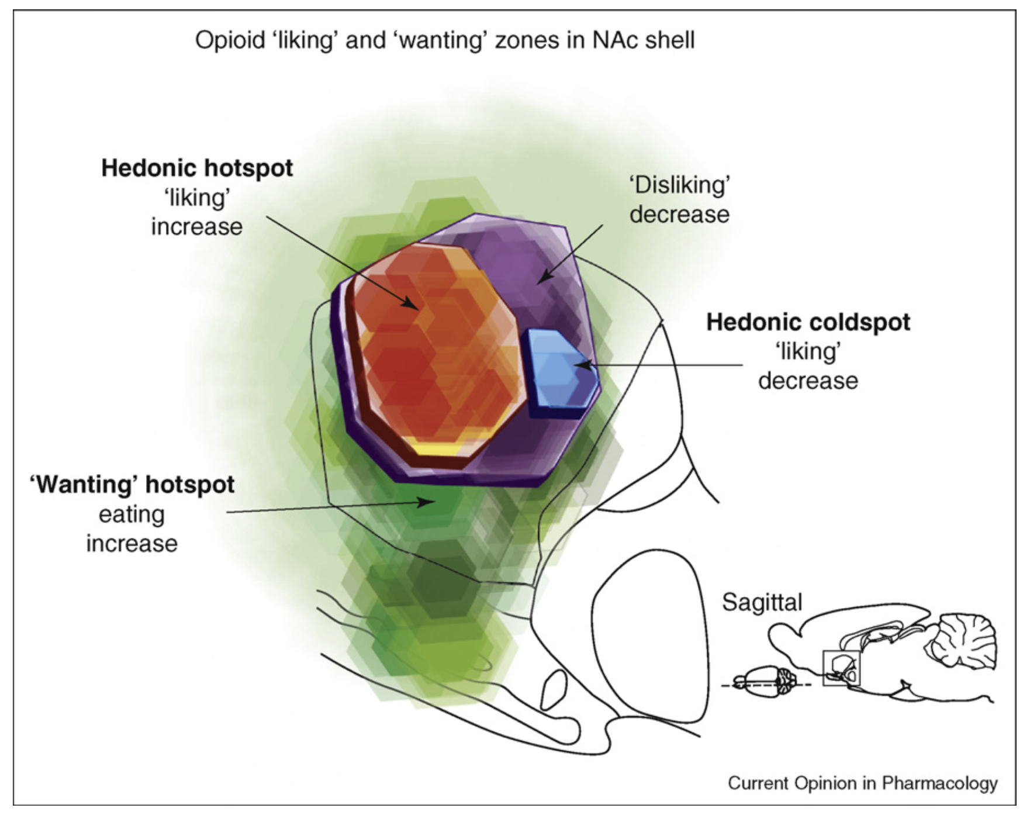
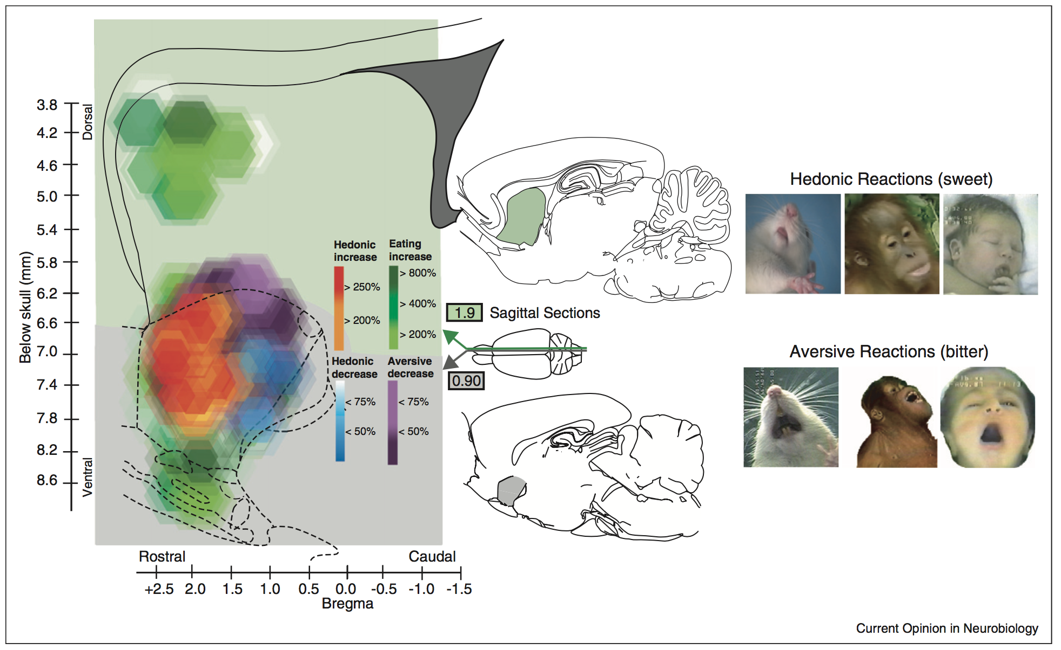
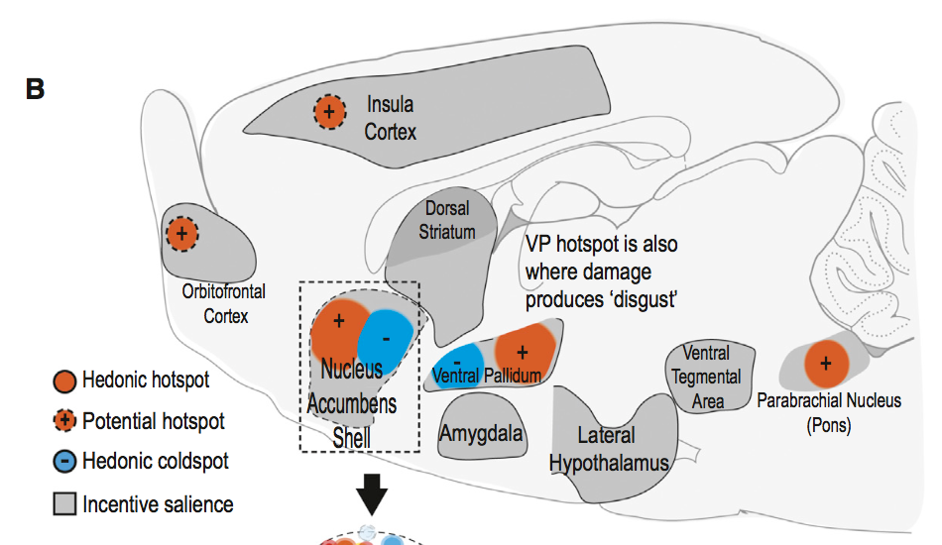
Berridge et al., 2009; 2013; 2015 Lecture 04
Where is the pleasure?
Opioid agonist (DAMGO) microinjections in hedonic hotspots (nucleus accumbens shell or ventral pallidum): Increases ‘liking’ reactions to sweetness
CHOONG-WAN WOO | COCOAN lab | http://cocoanlab.github.io
Notes:
CCK:CHOLECYSTOKININ
PYY:PEPTIDE YY
PP: Pancreatic polypeptide

Slide 22
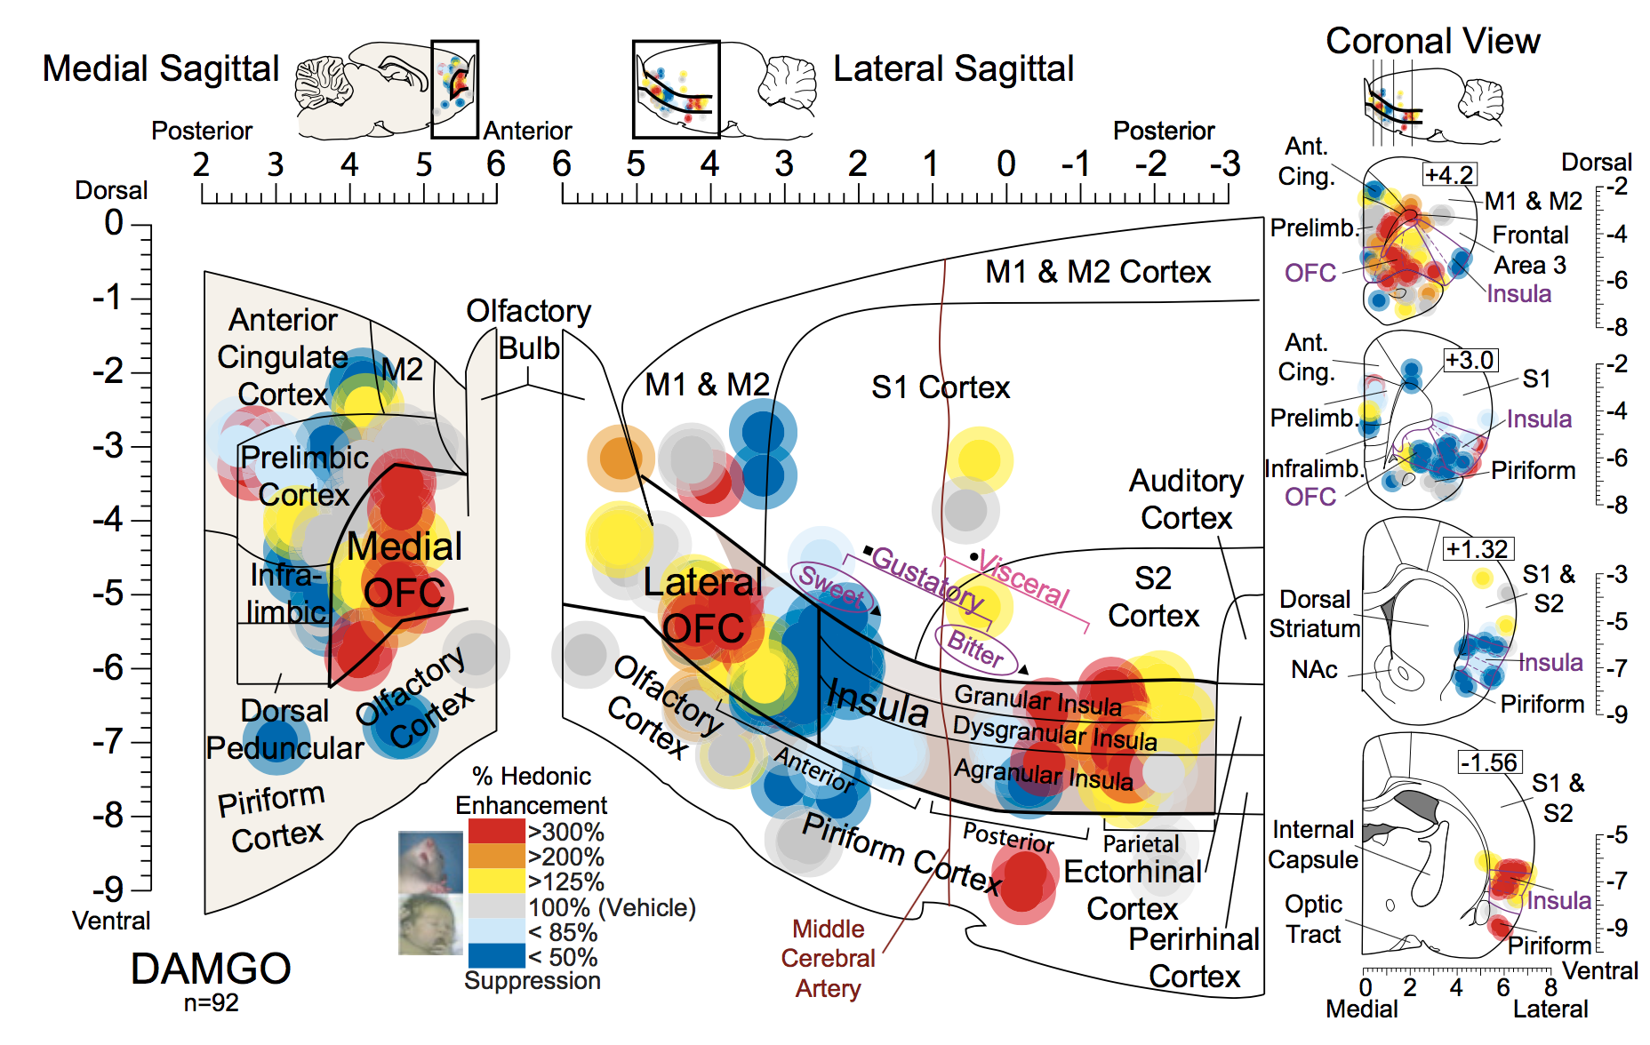
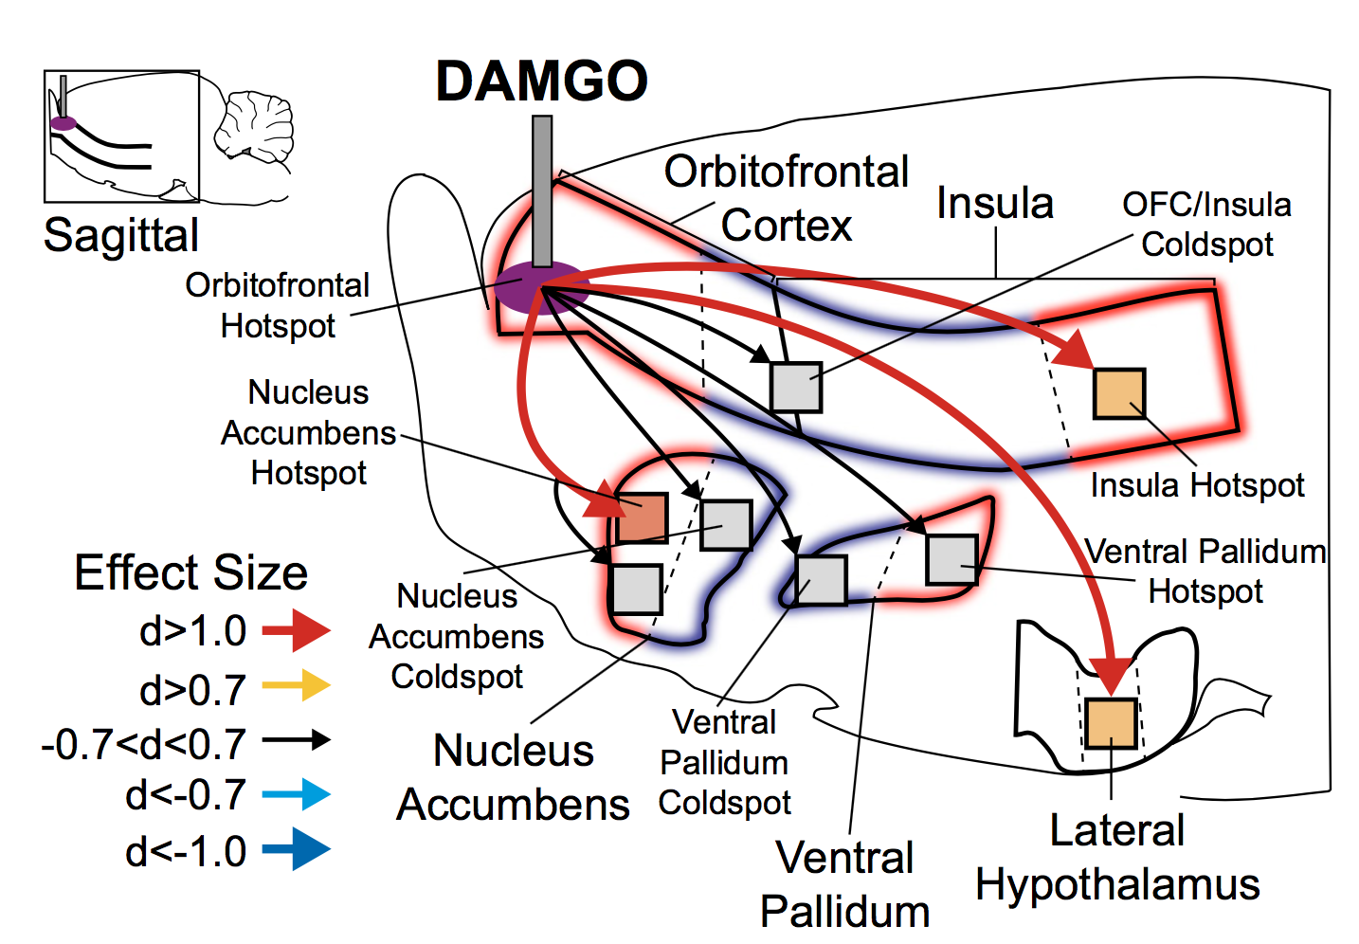
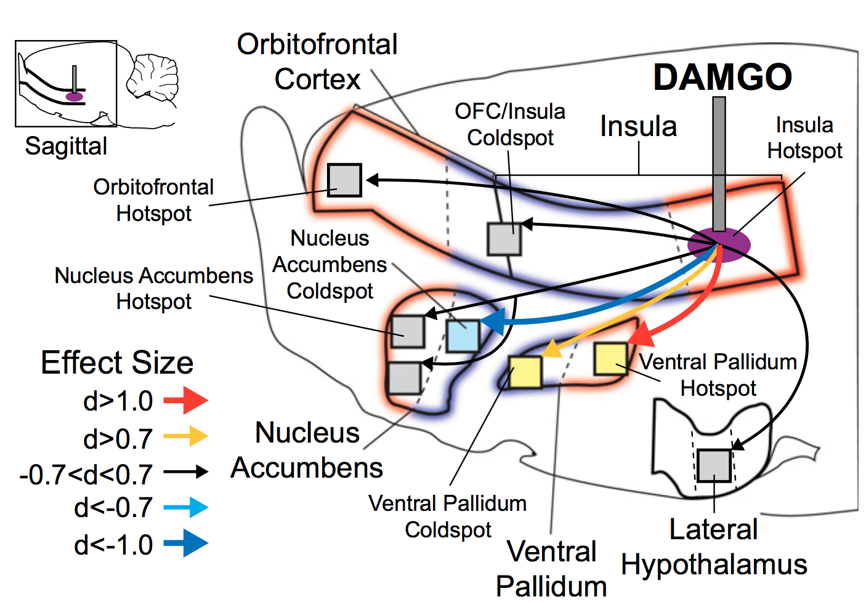
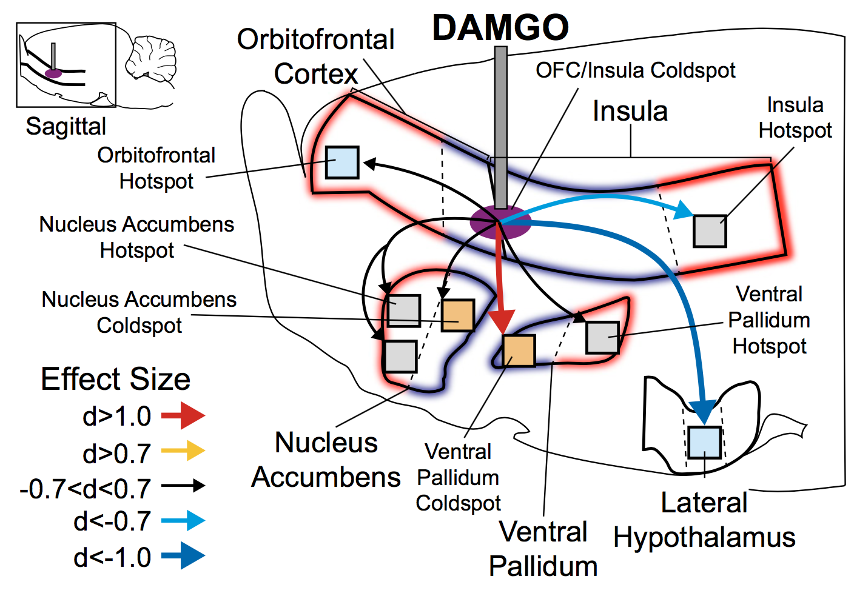
Castro & Berridge, 2017 Lecture 04
Where is the pleasure?
CHOONG-WAN WOO | COCOAN lab | http://cocoanlab.github.io
Notes:
CCK:CHOLECYSTOKININ
PYY:PEPTIDE YY
PP: Pancreatic polypeptide

Slide 23
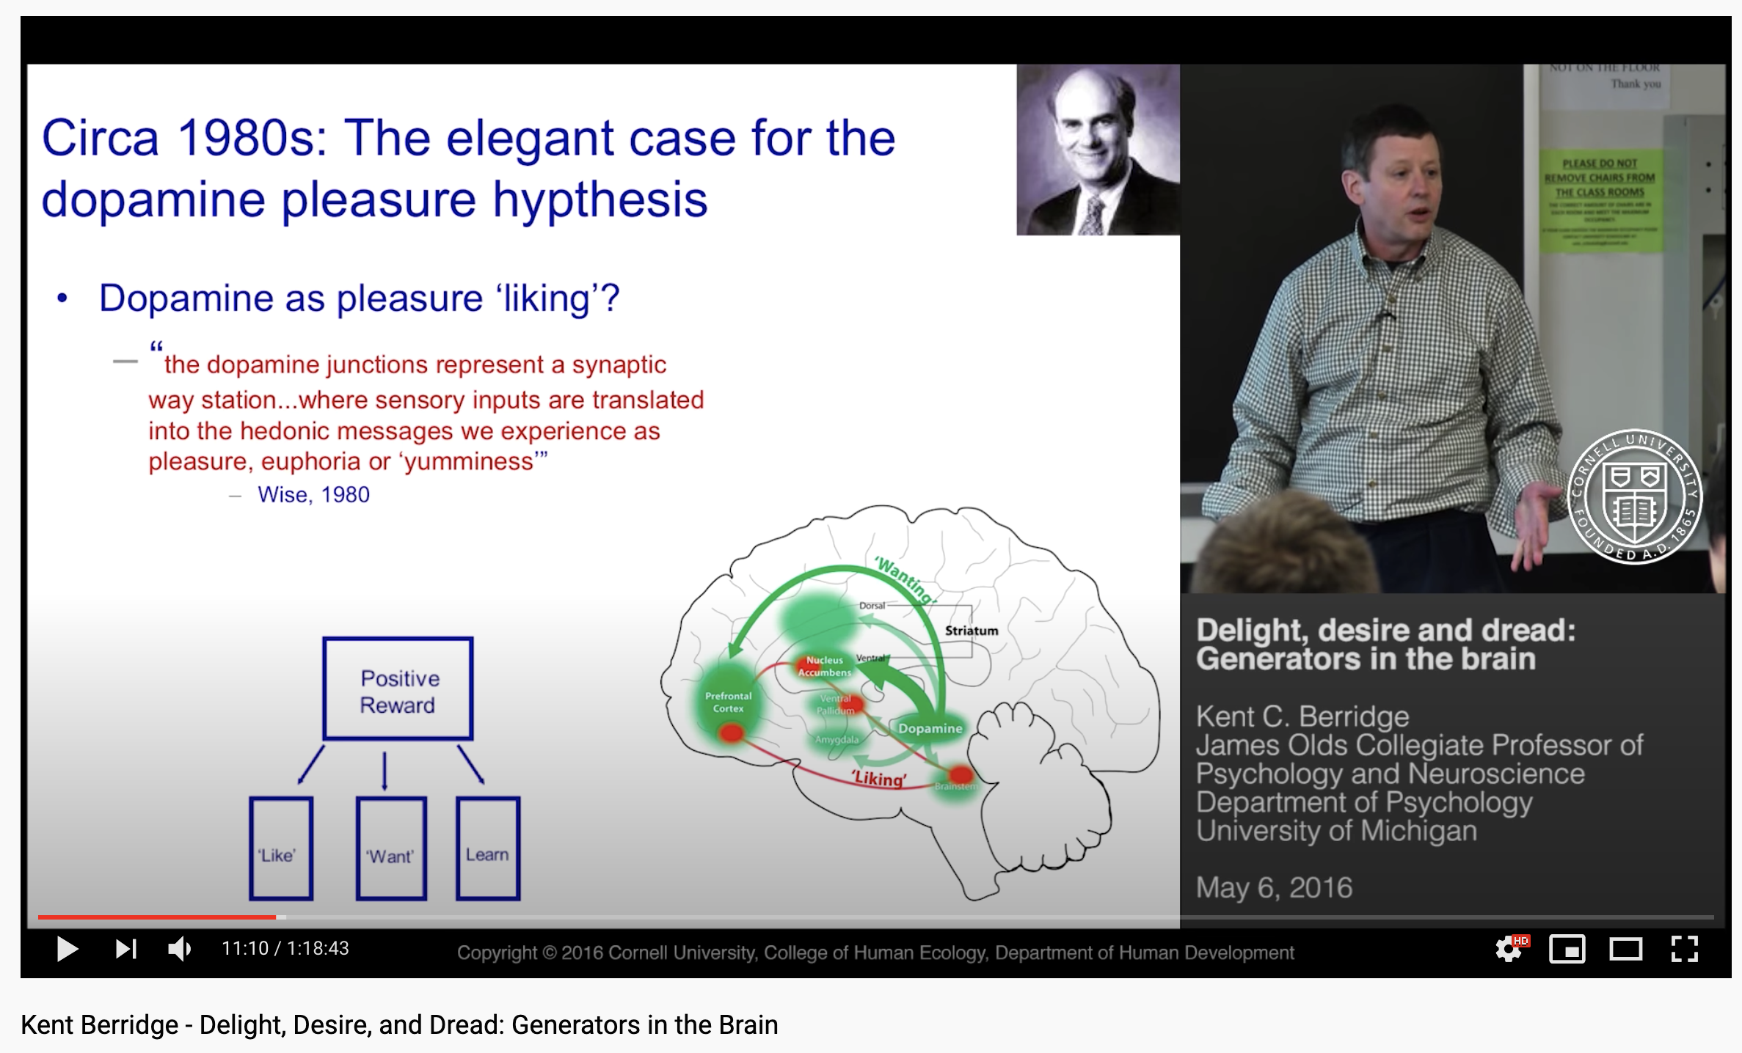
Lecture 04
Good video lecture by Kent Berridge
https://www.youtube.com/watch?v=hrf8FlVoR_I
CHOONG-WAN WOO | COCOAN lab | http://cocoanlab.github.io
Notes:
CCK:CHOLECYSTOKININ
PYY:PEPTIDE YY
PP: Pancreatic polypeptide

Slide 24
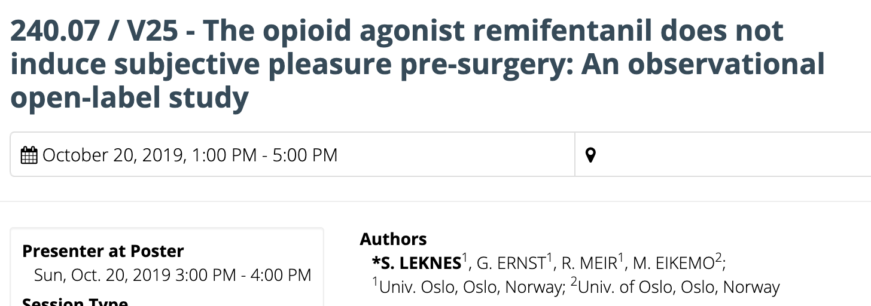
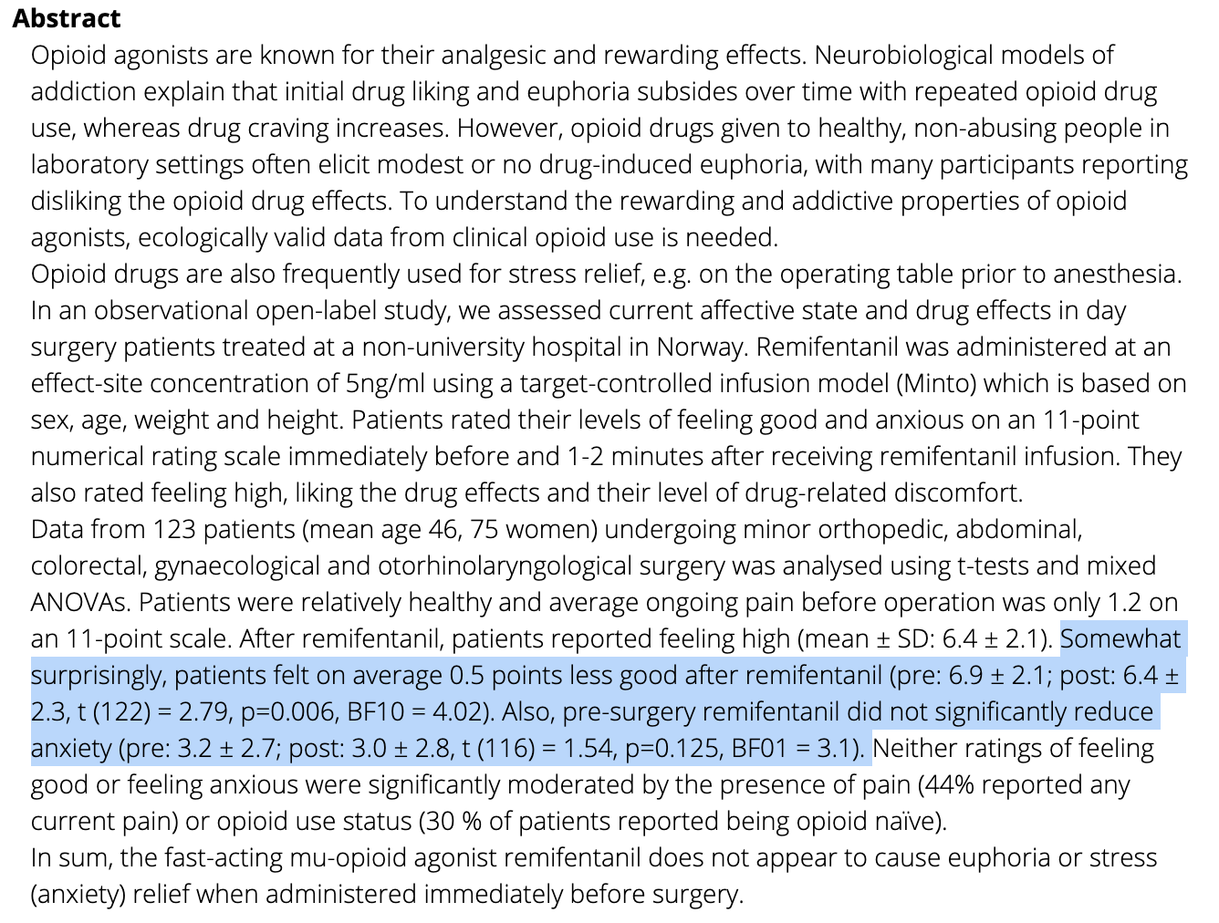
Lecture 04
But do opioid drugs really induce pleasure?
CHOONG-WAN WOO | COCOAN lab | http://cocoanlab.github.io
Notes:
CCK:CHOLECYSTOKININ
PYY:PEPTIDE YY
PP: Pancreatic polypeptide

Slide 25
Lecture 04
What’s missing?
Observing natural firing patterns, rather than drug injection
Conscious pleasure?
Other forms of pleasure beyond simple sensory pleasures?
Other areas that are also important?
CHOONG-WAN WOO | COCOAN lab | http://cocoanlab.github.io
Notes:
CCK:CHOLECYSTOKININ
PYY:PEPTIDE YY
PP: Pancreatic polypeptide

Slide 26
Lecture 04
Conscious pleasure as a common currency
CHOONG-WAN WOO | COCOAN lab | http://cocoanlab.github.io

Slide 27
Lecture 04
Common currency
Would you rather have the pleasure of a Mocha Frappuccino with a friend or the pleasure of going to class?
How do you integrate those different concepts into one representation of value?
“Beauty is a candy bar”; “Happiness is a hot fudge sundae.”
Cacioppo et al., 2012; Georgiadis and Kringelbach, 2012; Kringelbach et al., 2012; Parsons et al., 2010; Salimpoor et al., 2011; Vartanian and Skov, 2014; Veldhuizen et al., 2010; Vuust and Kringelbach, 2010; Xu et al., 2011; Zeki and Romaya, 2010
CHOONG-WAN WOO | COCOAN lab | http://cocoanlab.github.io
Notes:
CCK:CHOLECYSTOKININ
PYY:PEPTIDE YY
PP: Pancreatic polypeptide

Slide 28
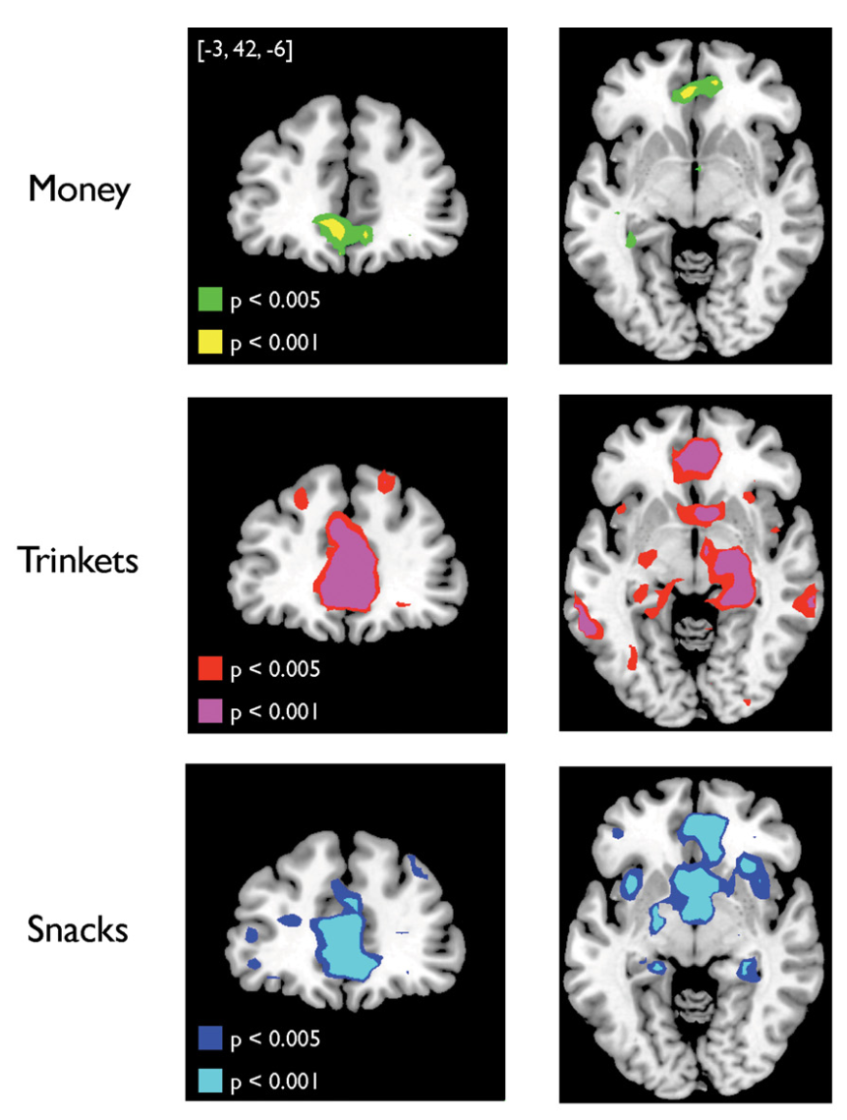
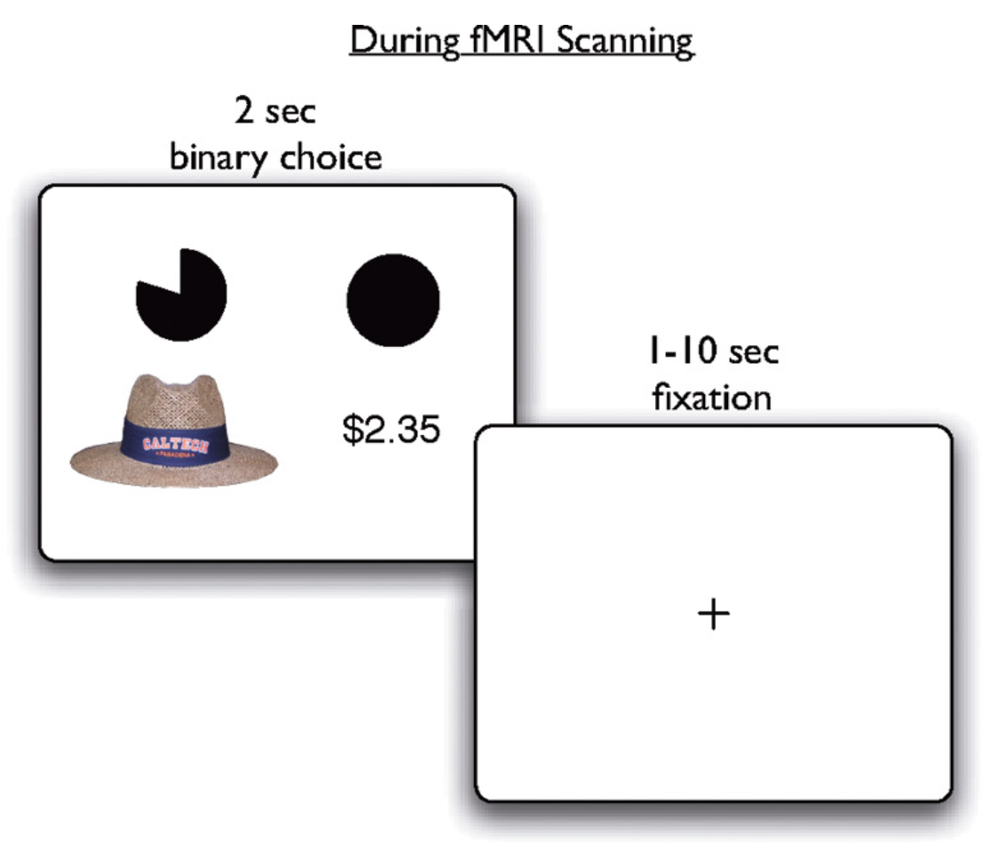
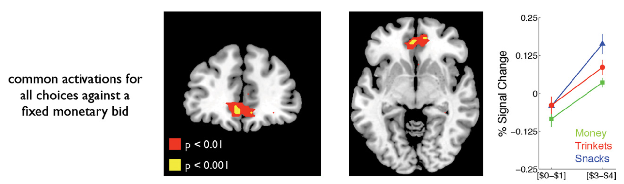
Chib et al., 2009 Lecture 04
VMPFC: valuation
CHOONG-WAN WOO | COCOAN lab | http://cocoanlab.github.io
Notes:
CCK:CHOLECYSTOKININ
PYY:PEPTIDE YY
PP: Pancreatic polypeptide

Slide 29
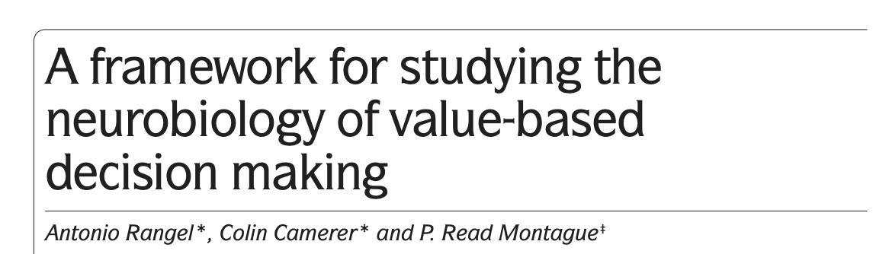
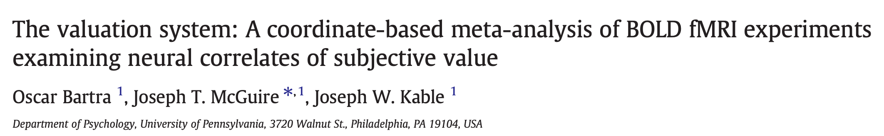
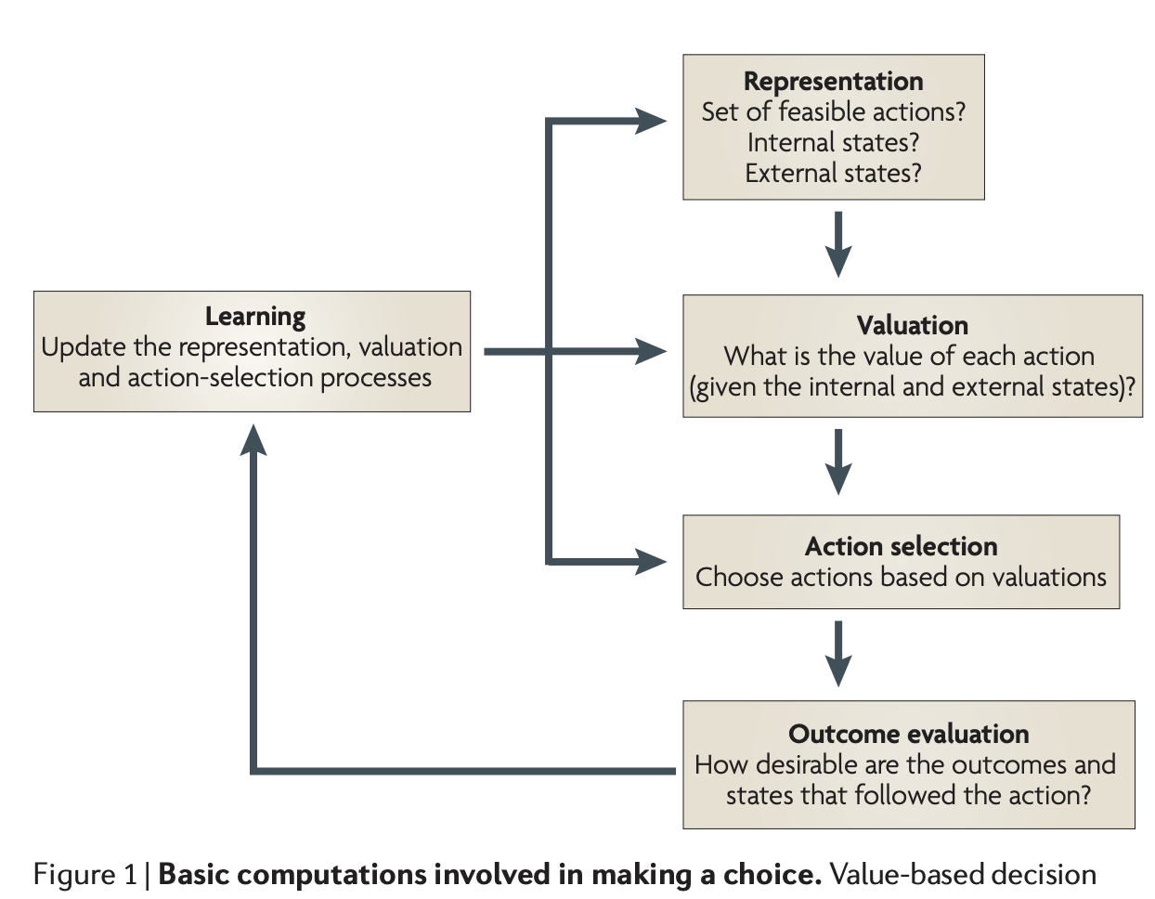
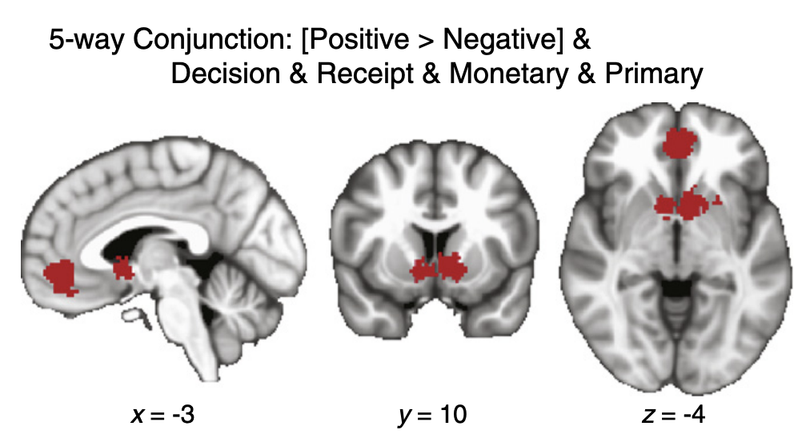
Lecture 04
CHOONG-WAN WOO | COCOAN lab | http://cocoanlab.github.io
Notes:
CCK:CHOLECYSTOKININ
PYY:PEPTIDE YY
PP: Pancreatic polypeptide

Slide 30
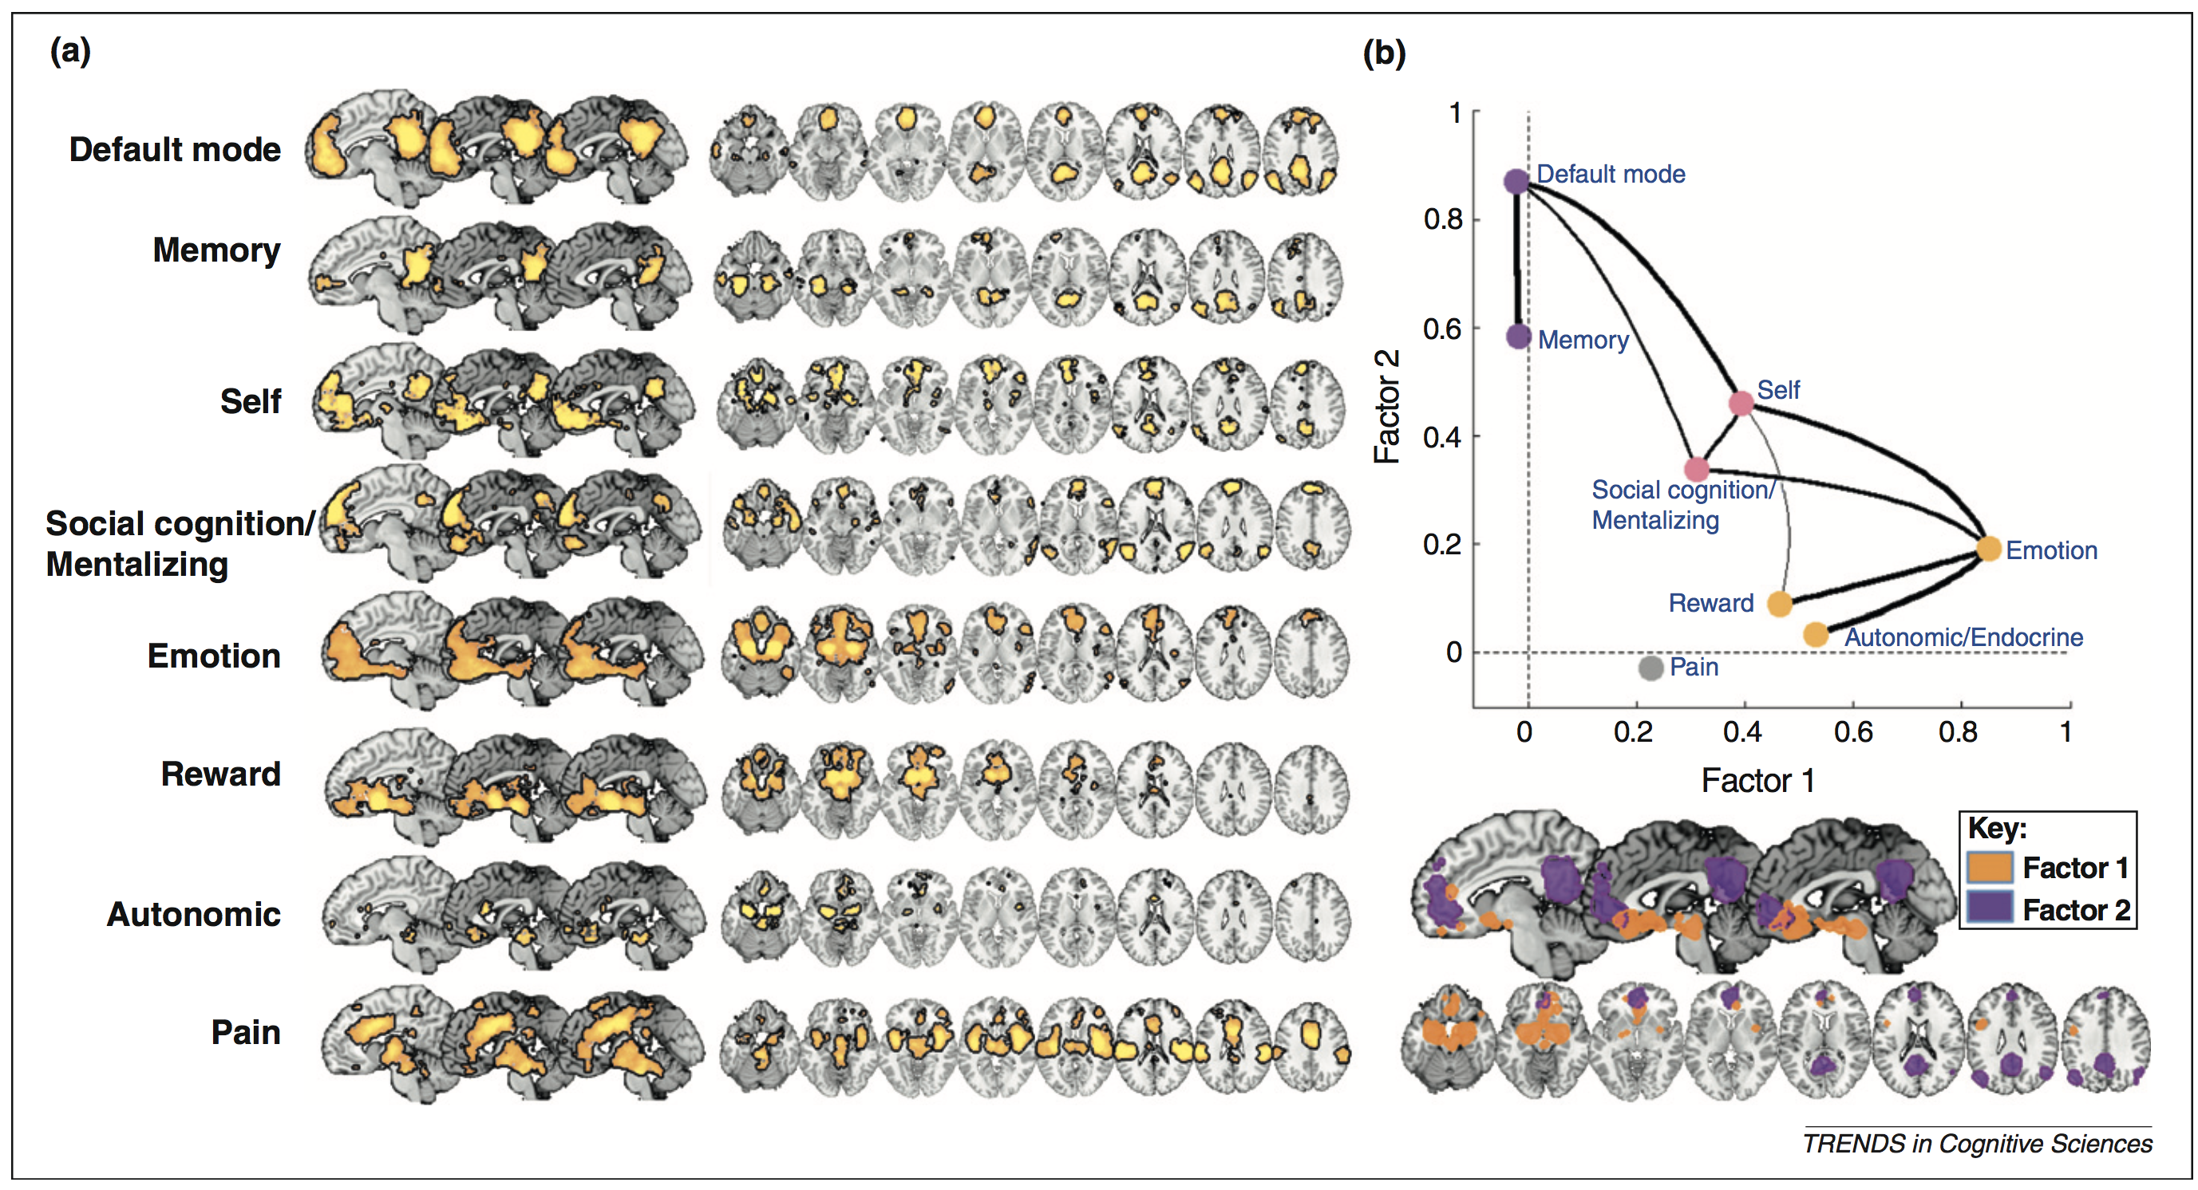
Roy et al., 2012 Lecture 04
VMPFC: meaning construction
CHOONG-WAN WOO | COCOAN lab | http://cocoanlab.github.io
Notes:
CCK:CHOLECYSTOKININ
PYY:PEPTIDE YY
PP: Pancreatic polypeptide

Slide 31
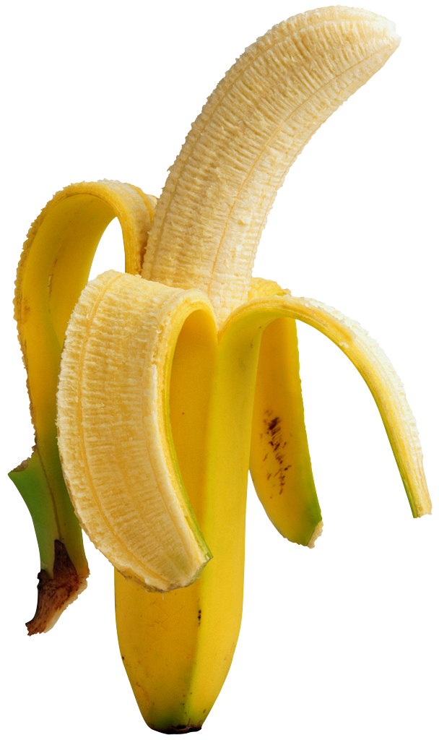
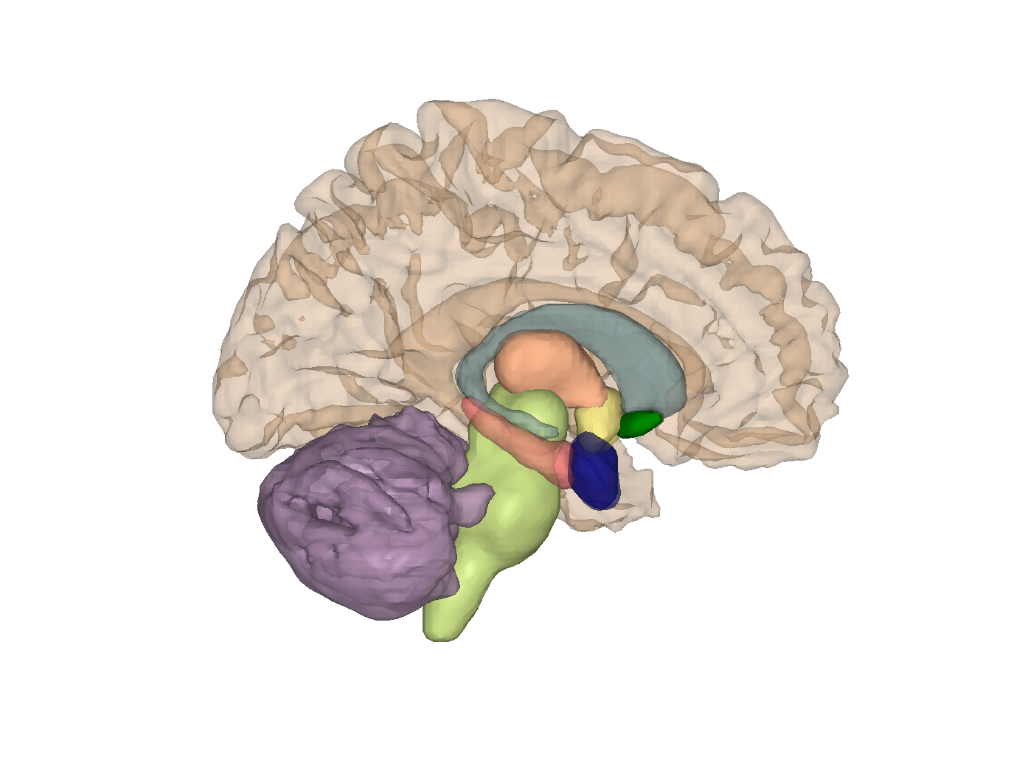
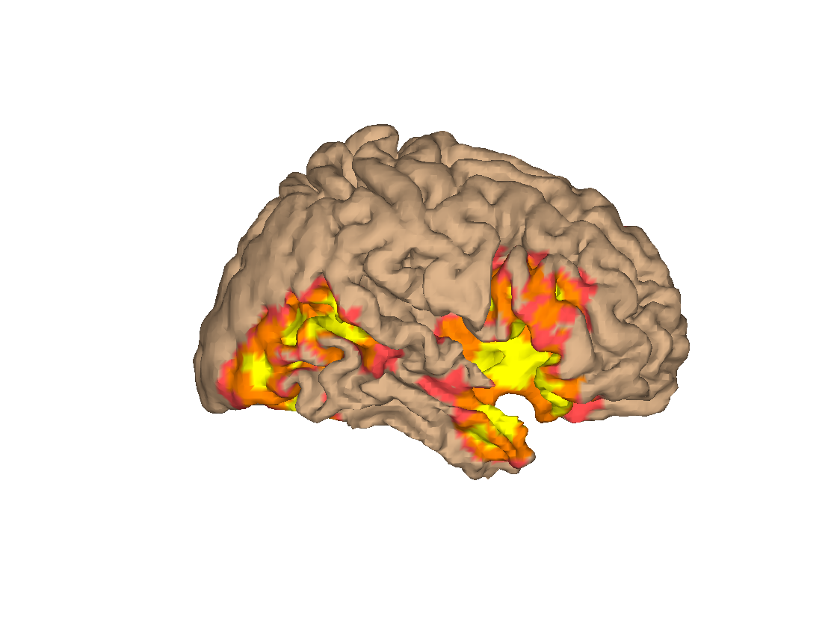
Lecture 04
VMPFC: meaning construction
Expected sensory hedonic value
Social: “People like me eat healthy fruit, not candy bars.”
Cognitive: “This banana
contains healthy K+”
Interoception: “I’m hungry”
Drive, arousal: “Get the banana”
CHOONG-WAN WOO | COCOAN lab | http://cocoanlab.github.io
Notes:
CCK:CHOLECYSTOKININ
PYY:PEPTIDE YY
PP: Pancreatic polypeptide

Slide 32
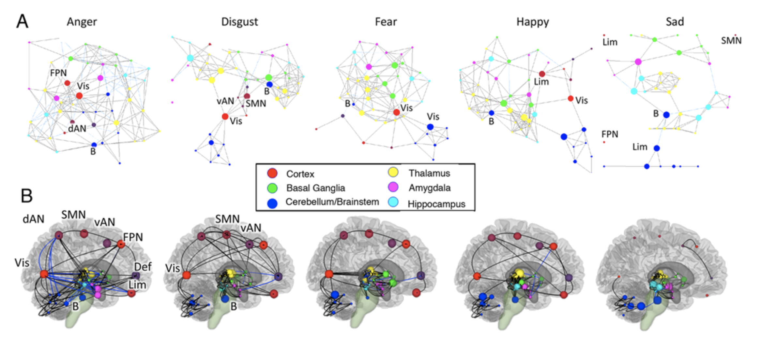
Wager et al., 2015 Lecture 04
But where is the pleasure, really?
What makes positive emotional events different from negative ones? Not one region!
Likely: Specific patterns/connections in ‘affective networks’
CHOONG-WAN WOO | COCOAN lab | http://cocoanlab.github.io
Notes:
CCK:CHOLECYSTOKININ
PYY:PEPTIDE YY
PP: Pancreatic polypeptide

